Slide 1

Pitcher X Analysis: Optimizing Whiff Probability
Data BASED Strategies for WHIFF Maximization
MICHAEL LEWIS-WEDDERBURN

Slide 2
Velocity Analysis & Findings
Overall Whiff Probability Correlation to Velocity Metrics
Release Speed: -0.442 (-0.325 Given a Swing Occurred)
Of all metrics, release speed has the most correlation to whiff probability more than any other one. However, there is an inverse correlation, so Pitcher X should consider throwing more off-speed pitches on the mound.
Spin Rate: 0.03 (.116 Given a Swing Occurred)
The correlation between spin rate and whiff probability is very low, so there is very little need to consider any aspect of aspect of spin rate in Pitcher X’s improvement.
Spin Axis: -0.339 (-0.319 Given a Swing Occurred)
Spin axis has one of the higher correlations to whiff probability, so Pitcher X should consider how the ball is spinning instead of how fast the ball is spinning.

Slide 3
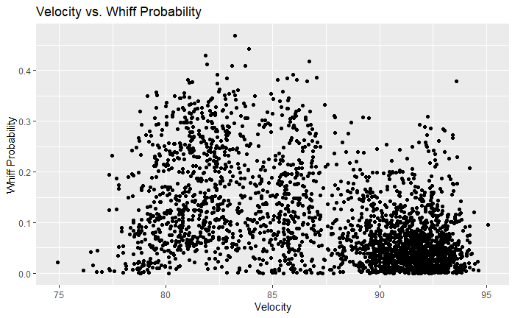
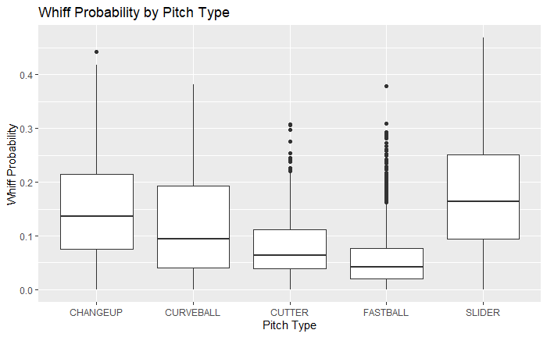
Velocity Analysis & Findings (Con.)
Overall Velocity vs. Whiff Probability Graph Findings
Trend on Fastballs: More Quantity of Fastballs But Lower Whiff Probabilities (Most Lower Than 0.1); Best/Worst Chances Between 90-93 mph.
Trend on Off-Speed Pitches: More Variability But Tends To Produce Higher Whiff Probabilities (>0.1); Best Chances Between 80-84 mph.
Overall Pitch Type vs. Whiff Probability Graph Findings
Trend on Fastballs: More Quantity of Fastballs But Lower Whiff Probabilities (Most Lower Than 0.1)
Trend on Cutters: Not the most effective pitch for whiff probabilities but has a slightly better chance than fastballs on average.
Trend On Sliders: Highest chance of whiffing; Most Variability (Biggest Range Not Including Outliers)
Overall Pitch Type vs. Whiff Probability Graph Findings (Con.)
Trend on Changeups: Second Highest Chance of Whiff Probability; Second Highest Variability
Trend on Curveballs: Middle of the Road; Less Variability Than Fastballs, But Similar Results

Slide 4
Velocity Improvement: Pitch Mixing Strategy
1. Speed Isn’t Everything
If only considering release speed, then Pitcher X should utilize his off-speed pitches more. Graph findings shows that there are some favorable pitches that have higher whiff probabilities other than Pitcher X’s standard fastball. Off-speed tend to have different spin axes than fastballs, which could a reason why that correlation to whiff probability is higher than just spin rate.
2. Choose the Right Pitch at the Right Time
Average whiff probabilities for each pitch type are really close (mostly from 0.1 to 0.2), so small changes is what works best. Because of this, Pitcher X can sacrifice velocity for other aspects that could increase whiff probability more if he throws a lower number of fastballs and more off-speed pitches.

Slide 5
Movement Analysis & Findings
Overall Whiff Probability Correlation to Movement Metrics
Vertical Break: -0.341 (-0.248 Given a Swing Occurred)
Of the movement metrics specifically, induced vertical breaking is more important and induced horizontal breaking, so Pitcher X should consider eye level changes from 6-12 more than 3-9 on the mound.
Horizontal Break: -0.291 (-0.278 Given a Swing Occurred)
Although induced horizontal breaking is not as prevalent to whiff probability in comparison, Pitcher X can also consider pitches with more horizontal break in unison with more vertical breaking to optimize whiff probability as much as possible.

Slide 6
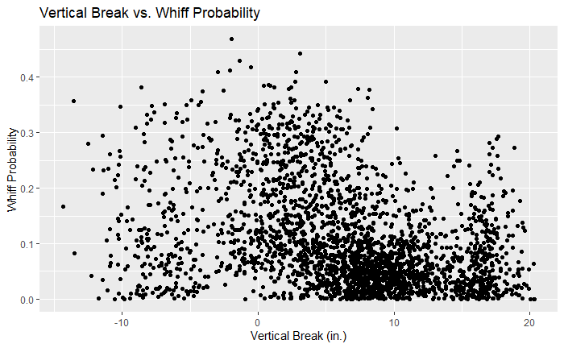
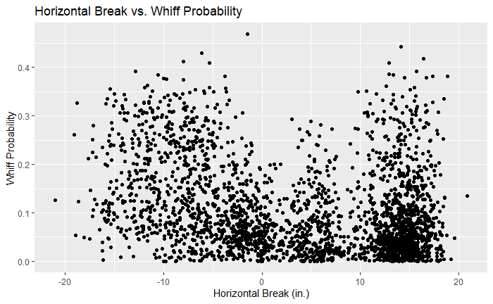
Movement Analysis & Findings (Con.)
Overall Movement vs. Whiff Probability Graph Findings
Trend on Vertical Break: Lower whiff probabilities tend to be in the densest areas (Between 5 and 10 ft.). If Pitcher X is looking to find the right balance in his breaking ball, he should consider inducing the vertical break 5 inches less on average to stay within the 0-5 in. range.
Trend on Horizontal Break: More extreme horizontal breaks (positive or negative) tend to produce higher whiff probabilities (beyond 10 in. each side). Picher X should avoid no horizontal movement for the best optimization.

Slide 7
Movement Improvement: Continuous Adjustment
1. Vertical > Horizontal
Letting gravity take over movement is a better option for Pitcher X as vertical breaking is more directly correlated to whiff probability, but less vertical breaking tends to produce similar results. Horizontal breaking still somewhat matters but adjust it with vertical breaking to optimize whiffing more often.
2. Find the Right Movement to Utilize Other Aspects
Overall, release speed and spin axis are very correlated to breaking (RSC: 0.821 (IVB) and 0.639(HB)) (0.683 (IVB) and 0.847(HB)), so finding the right movement overall can help show what velocity ranges are best for optimizing whiff probability.

Slide 8
Location Analysis & Findings
Whiff Probability Correlation to Location Metrics
Plate Height: -0.321 (-0.53 Given a Swing Occurred)
Location metrics have more emphasis in comparison because hitters will often try to predict location over velocity, movement, and pitch release. Plate height has one of the higher correlations to whiff probability, but the inverse relationship indicates that lower pitches towards ground level should be considered. Moreover, plate height also has the highest correlation if the batter swings, so Pitcher X should adjust how low his pitches are coming in along with mixing up the velocities.
Plate Side: -0.106 (-0.461 Given a Swing Occurred)
Although the plate side metric correlation may not be very relevant regarding overall whiff probability, it does hold much significance if the pitcher swings. The best way to improve plate side distance would be inducing the hitters to swing, so it can be adjusted if a batter struggles in a certain zone of the batter’s box.

Slide 9
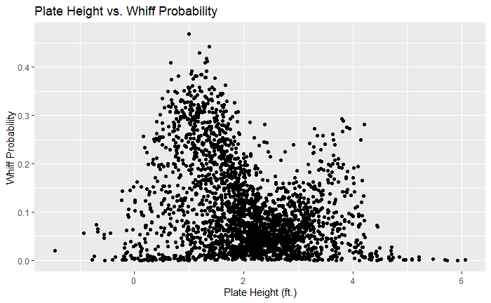
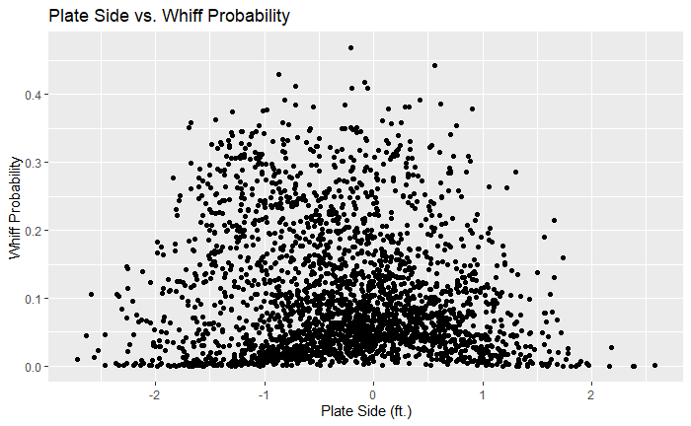
Location Analysis & Findings (Con.)
Overall Location vs. Whiff Probability Graph Findings
Trend on Plate Height: The best chances for whiffing often happens when the pitch is about a foot off the ground then it starts to get lower around the 2-3 ft. range. It starts to become a higher chance when it’s about 4 ft. off the ground and anything beyond that is close to zero. Pitcher X should focus on lower zones and not giving batters more chances to swing in those middle zones.
Trend on Plate Side: To maximize whiff probability, most of Pitcher X’s pitches should not deviate from the middle of the plate. There are higher chances when the pitches do not stray from more than a foot. Beyond a foot is where the chances significantly decrease. This should not be at the top of Pitcher X’s consideration, but rather something to think about.

Slide 10
Location Improvement: Exploiting Hitter Weaknesses
1. (Lack of) Height Is Key
Location has the potential to affect whiff probability more than any other aspect. If Pitcher X focuses more keeping his pitches low, especially by inducing more swings from it, then the probability of whiffing can be maximized.
2. Exploit Favorable Zones
Mixing location metrics with other metrics such as vertical breaking (due to high correlation between each other), can be the key to finding favorable zones for Pitcher X. It can also be used to exploit cold zones for batters as well.

Slide 11
Release Point Analysis & Findings
Whiff Probability Correlation to Release Point Metrics
Release Height: -0.273 (-0.206 Given a Swing Occurred)
Although not the most important metric overall, the height of the release point plays an influence on other pitching aspects previously discussed. There is some correlation to whiff probability as well, so the inverse relationship indicates that lower release points should be something Pitcher X readjusts.
Release Side: 0.199 (0.059 Given a Swing Occurred)
There is a somewhat positive correlation when taking the release point side distance in consideration (indicating that some release points that are off the center of the mound could increase whiff probability), but it is not significant enough to completely readjust Pitcher X’s pitching form. Moreover, inducing a swing from pitches also lowers this metric’s correlation, so Pitcher X does not need to focus on pitch release side distance in comparison.

Slide 12
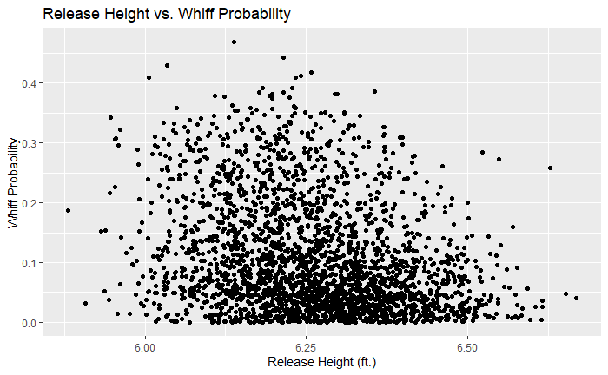
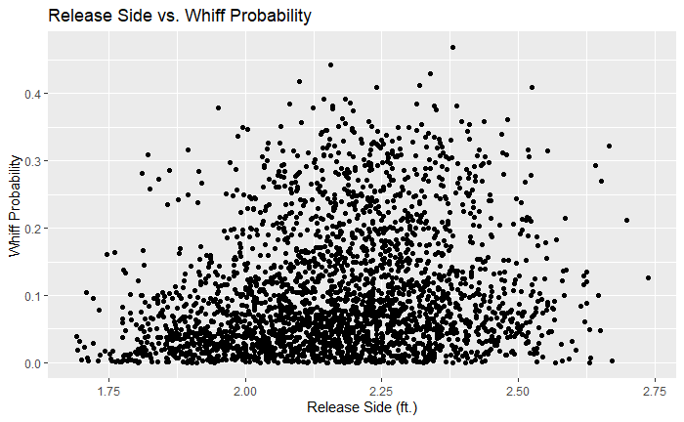
Release Point Analysis & Findings (Con.)
Overall Release Point vs. Whiff Probability Graph Findings
Trend on Release Height: Pitcher X should keep the release height around 6-6.25 ft. for whiff probability maximization. There is a slight downward trend beyond 6.25 ft. and a greater downward trend beyond 6.5 ft.
Trend on Release Side: Pitcher X should focus on releasing the ball closer to third base rather than straight towards the batter’s box. There is an upward trend as the side release gets closer to 2.375 ft. approximately.
Consistently finding those points around those ranges is essential.

Slide 13
Release Point Improvement: Consistent Releases
1. Balance Consistent Height & Side Releases
Pitcher X’s most consistent release points are the key to optimizing whiff probability. Knowing when to release it and far to release it can create more favorable options for all pitch types (as there are similar correlations for most pitch types).

Slide 14
Overview and Q&A
Suggestions For Maximizing Whiff Probability
Velocity: More Frequent Pitch Mixing
Movement: Keep It Really Far, Really Close, and Let Gravity Take Over
Location: Find More Favorable Zones
Release Point: Have More Consistent Release Points
Overall, different kind of metrics can be mixed and matched together to maximize whiff probability for a particular scenario, so Pitcher X doesn’t have to solely focus on just one aspect of his pitching performance.
Q&A: Questions, Comments, Concerns, Ideas

